Slide 1

Wi-Fi enabled Edge Avoiding Robot
Module
Rohit Kumar

Slide 2
Contents
Title | Page
Introduction
Hardware Required
Description
IR Sensor
Edge Avoiding Robot Algorithm
Connecting ESP8266 to Local XAMPP server
Creating Database and table
Setup connection with database
Accessing data in phpMyAdmin Database

Slide 3
Edge Avoiding Robot
The purpose of this robot is to keep moving on a platform without falling from it. For this it detects the edge of the platform and avoid edge by turning to opposite side for example if it detects an edge to its right, it turns to left and vice versa. And send the status of robot to phpMyAdmin database.

Slide 4
Hardware requirements
Arduino Uno
ESP8266 Wi-Fi module
2 IR sensors
DC Motor Driver L293D
DC Motor
Power Supply

Slide 5
Description
The sensors are mounted at front end of the robot at both left and right side. The sensors are designed to detect the light reflecting from the platform on which it is moving and at the edge, sensors don’t get this light. The robot starts moving on platform and until it is on the platform it is receiving the reflected light and robot keeps moving. As soon as it reaches the edge (say left edge), the left sensor doesn’t receives the light and the comparator sends logic 0 to the microcontroller for the left sensor. On getting this condition the microcontroller make the robot to turn right by turning only the left motor ON and making the right side motor OFF. Reverse will happen if the right sensor detects the edge.
In this way the robot keeps moving on the platform and doesn’t fall by avoiding the edges.
And we are able to send status of robot to phpMyAdmin database.

Slide 6
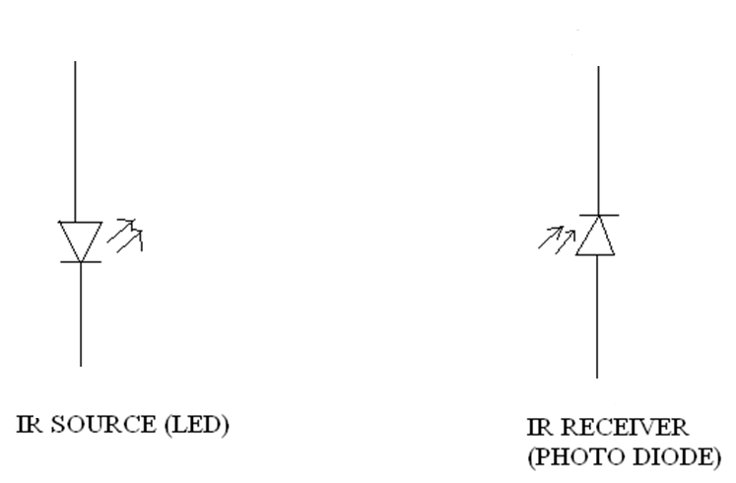
IR sensor basically consist an IR LED and a Photodiode, this pair is generally called IR pair or Photo coupler. IR sensor work on the principal in which IR LED emits IR radiation and Photodiode sense that IR radiation. Photodiode resistance changes according to the amount of IR radiation falling on it, hence the voltage drop across it also changes and by using the voltage comparator (like LM358) we can sense the voltage change and generate the output accordingly.
IR Sensor

Slide 7
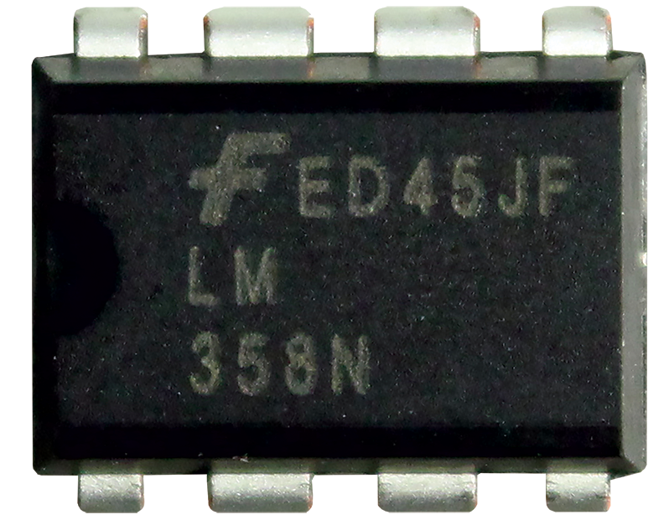
Voltage Comparator
A comparator is a device which compares two voltages or currents and switches its output to indicate which is larger.
Comparator is On-Amp.

Slide 8
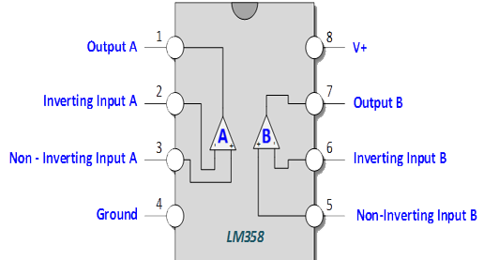
Pin Diagram

Slide 9
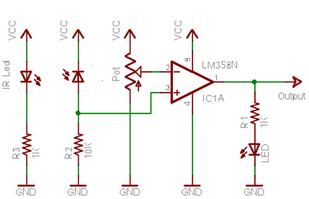
Circuit Diagram

Slide 11
Edge Avoider
LEFT SENSOR | RIGHT SENSOR | MOVEMENT
ON | ON | FORWARD
OFF | ON | DELAY; RIGHT TURN; DELAY;
ON | OFF | DELAY; LEFT TURN; DELAY;
OFF | OFF | DELAY; RIGHT TURN; DELAY;

Slide 12
Connecting ESP8266 to Local XAMPP server
Now we connect our Arduino with ESP8266 Wi-Fi module to send data to database wirelessly.
Then we have to install XAMPP server so that we can use local server for transmission of data and also able to create MySQL database to save value.
Go to this link for installation of XAMPP server :- https://www.apachefriends.org/index.html

Slide 13
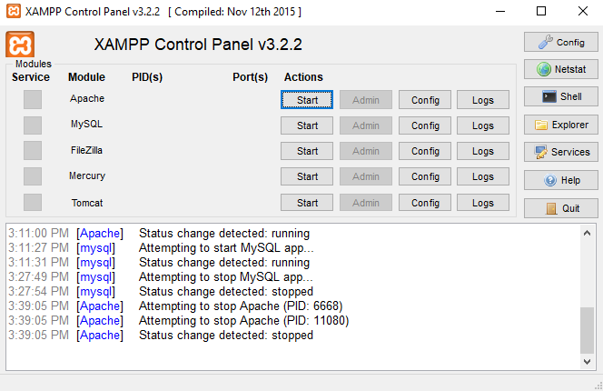
After installation of XAMPP you will get this window:-

Slide 14
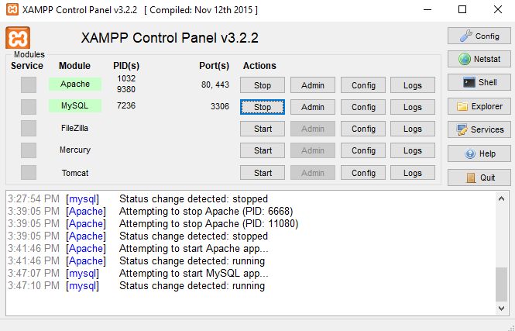
Start the Apache and MySQL module
Click on Netstat to note the IP address used by server.

Slide 15
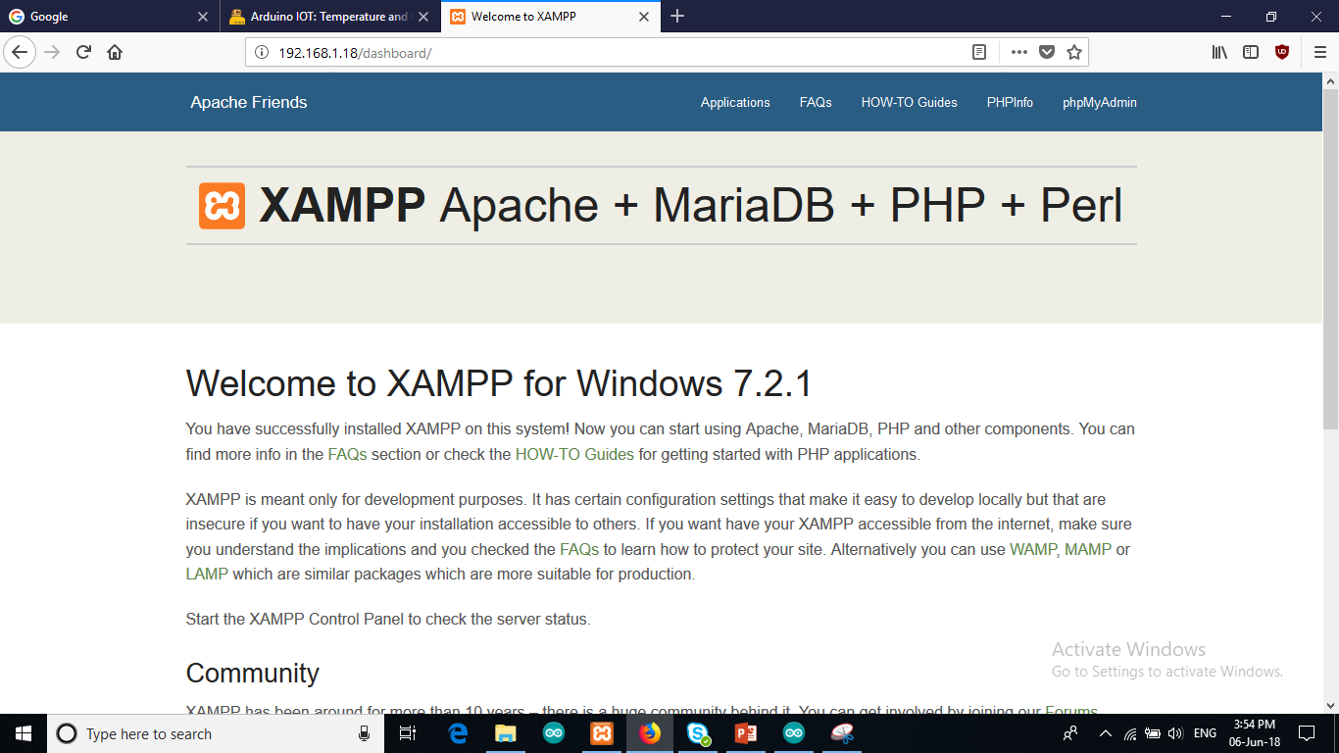
Type this IP address in your browser
Then you will get dashboard of XAMPP.
Click on phpMyAdmin.
Now you will get a screen where you can create your database.

Slide 16
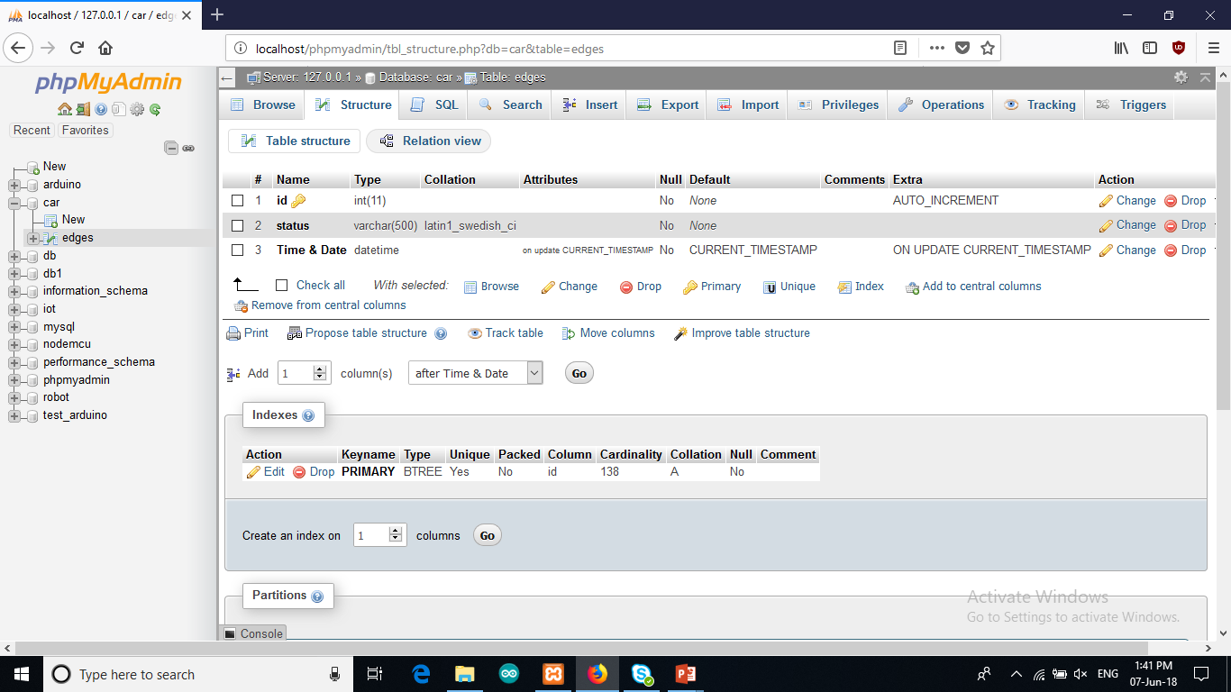
Click on New tab -> Enter the name of database and then click on create.
Now enter the name of table and set no. of columns to 3.
Fill the entries in columns same as image above.
Now we are done with database.

Slide 17
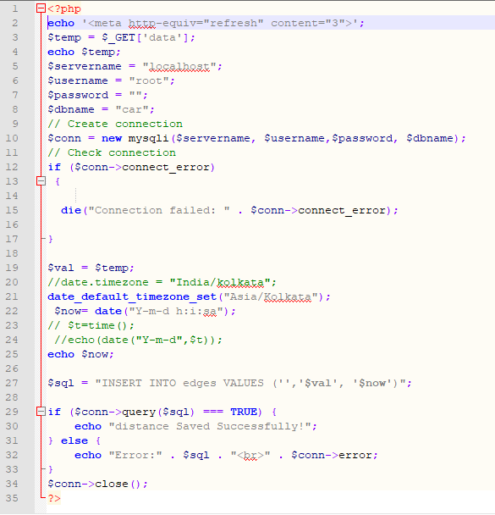
Setup connection with database
In this php code we are establishing connection with database to send value to database.
You need to set your username, password, dB name, and table name same as you created.

Slide 18
Final Setup
Now open Arduino IDE.
Select board as Arduino Uno
And select your port.
Open your code file and upload the code in Arduino.
Now open your serial monitor check whether you are getting the right output or not.
Then open your browser enter : <ipaddress>/yourphpfile.php
Now when you open your phpMyAdmin database you will get the distance measured by sensor.

Slide 19
Thank You !
Contact US
Nitin Sinha
nitin.sinha@goSigmaWay.com
+1 727-394-4375
+91 7838188809
Debjani Mitra
debjani.mitra@goSigmaWay.com
+1 952-583-3449
+91 9339555636
Rohit Kumar
rohit.kumar@sigmaway.us
+91 7982577830
+91 7838021754

